Slide 1
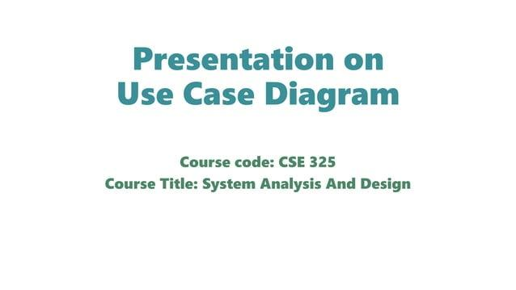

Slide 2
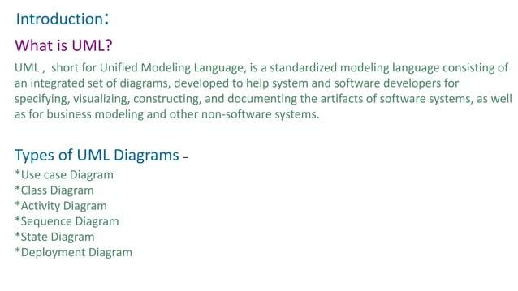

Slide 3
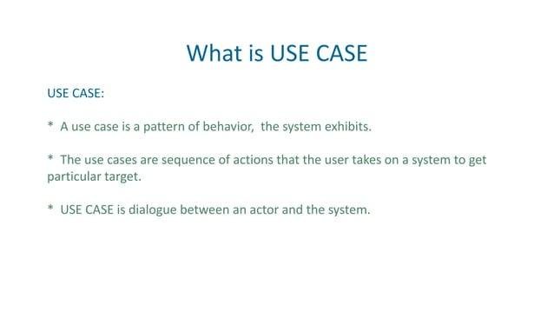

Slide 4
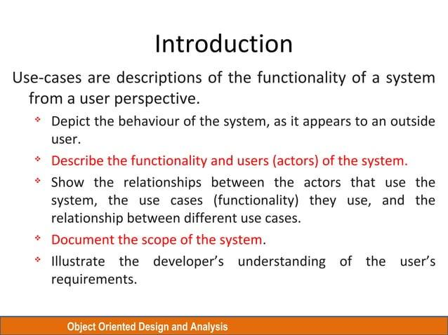

Slide 5
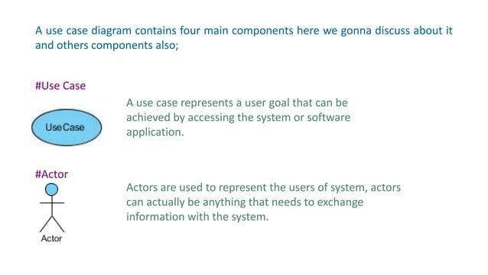
1
2

Slide 6
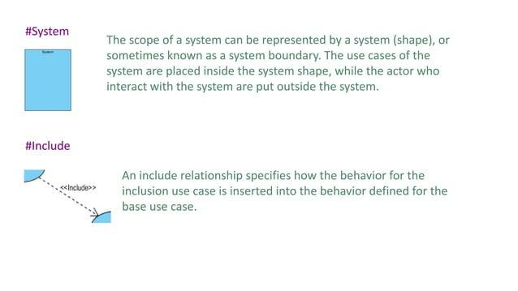
3
4. Connectors

Slide 7
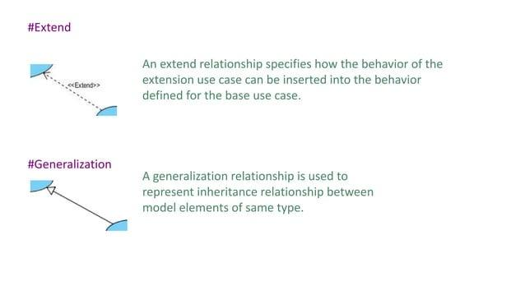
1

Slide 8
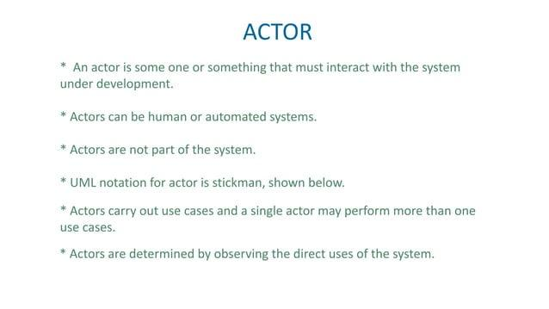

Slide 9
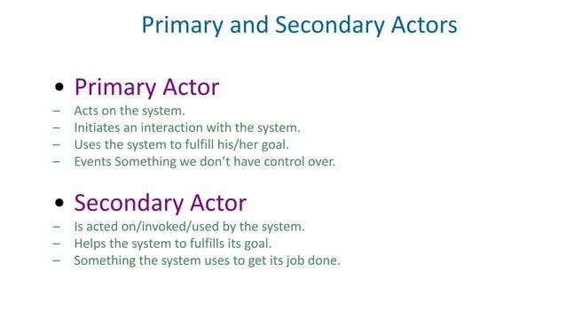

Slide 10
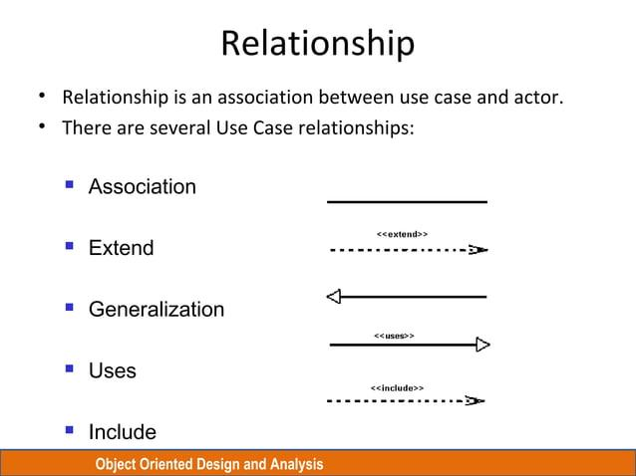

Slide 11
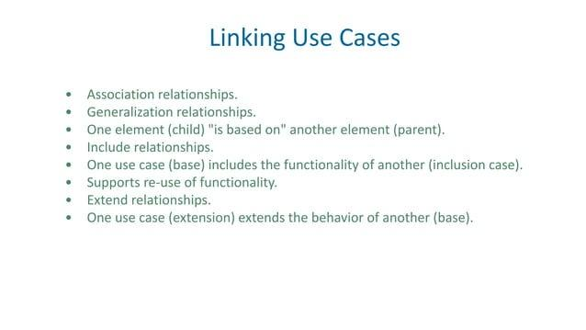

Slide 12
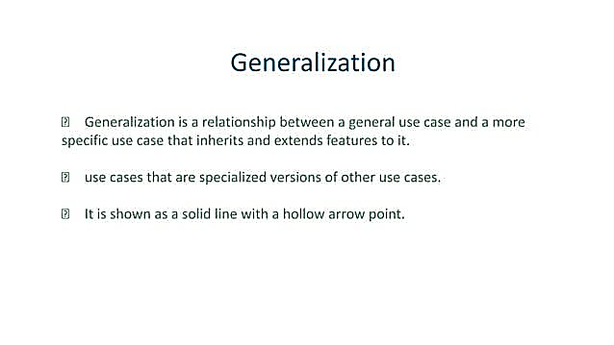

Slide 13
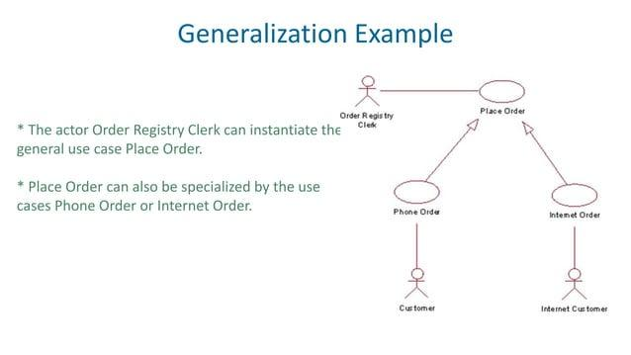

Slide 14
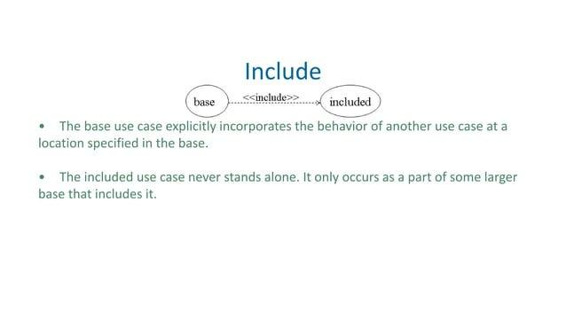
Base Use Case | Included Use Case | Relationship | Explanation
Withdraw Funds | Verify PIN | Withdraw Funds $\ll \text{include} \gg$ Verify PIN | To Withdraw Funds, the system must execute the Verify PIN process.
Check Balance | Verify PIN | Check Balance $\ll \text{include} \gg$ Verify PIN | To Check Balance, the system must execute the Verify PIN process.

Slide 15
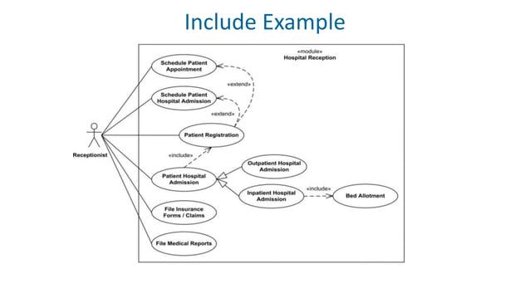

Slide 16
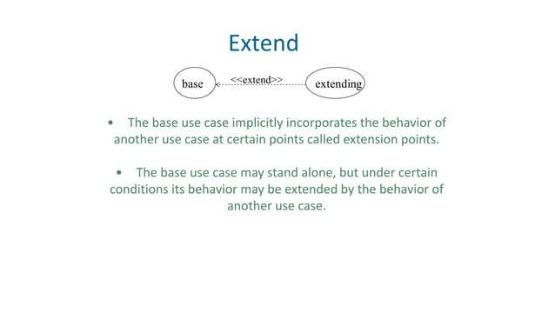

Slide 17
Base Use Case | Extending Use Case | Condition | Relationship
Withdraw Funds | Print Receipt | The user selects the "Yes" option for a receipt. | Withdraw Funds $\ll \text{extend} \gg$ Print Receipt
Process Transaction | Notify Fraud Department | The account is overdrawn or the amount is suspicious. | Process Transaction $\ll \text{extend} \gg$ Notify Fraud Department

Slide 18
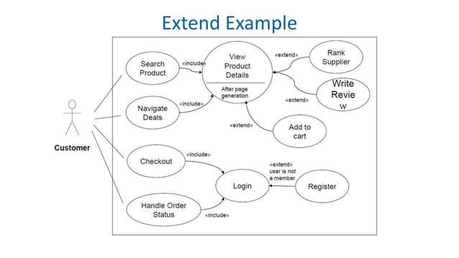
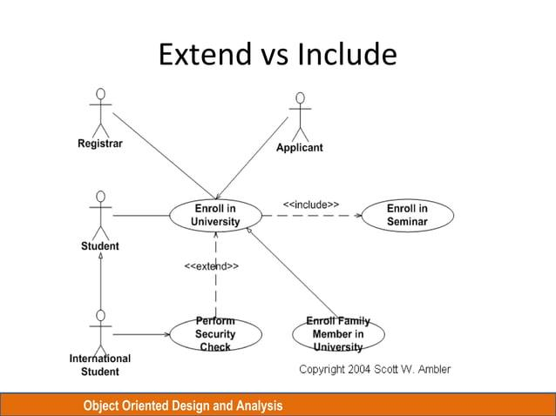

Slide 19
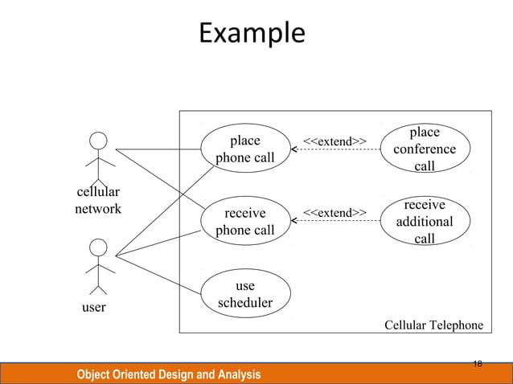

Slide 20
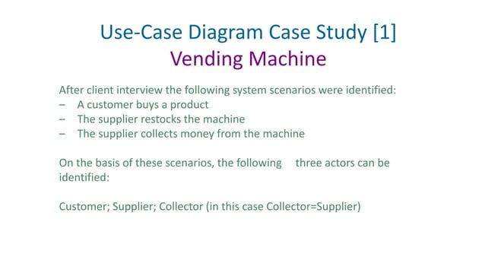

Slide 21
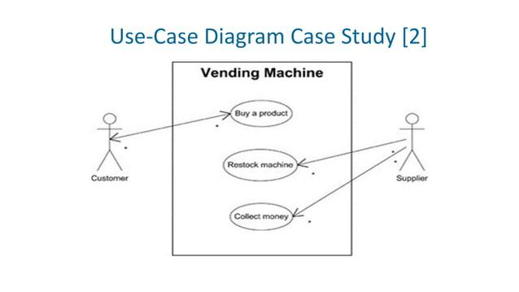

Slide 22
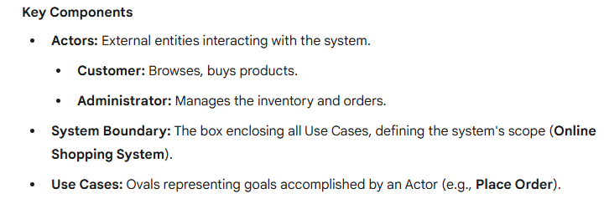
🛒 Use Case Diagram: Online Shopping System

Slide 23
🛒 Use Case Diagram: Online Shopping System
Actor | Primary Use Cases (Goals) | Relationships
Customer | View Products, Login, View Cart, Place Order | Place Order $\ll \text{include} \gg$ Process Payment (Payment is a mandatory step)
Administrator | Manage Products, Manage Orders | View Products $\ll \text{extend} \gg$ Review Product (Reviewing is an optional step)

Slide 24
